Slide 1
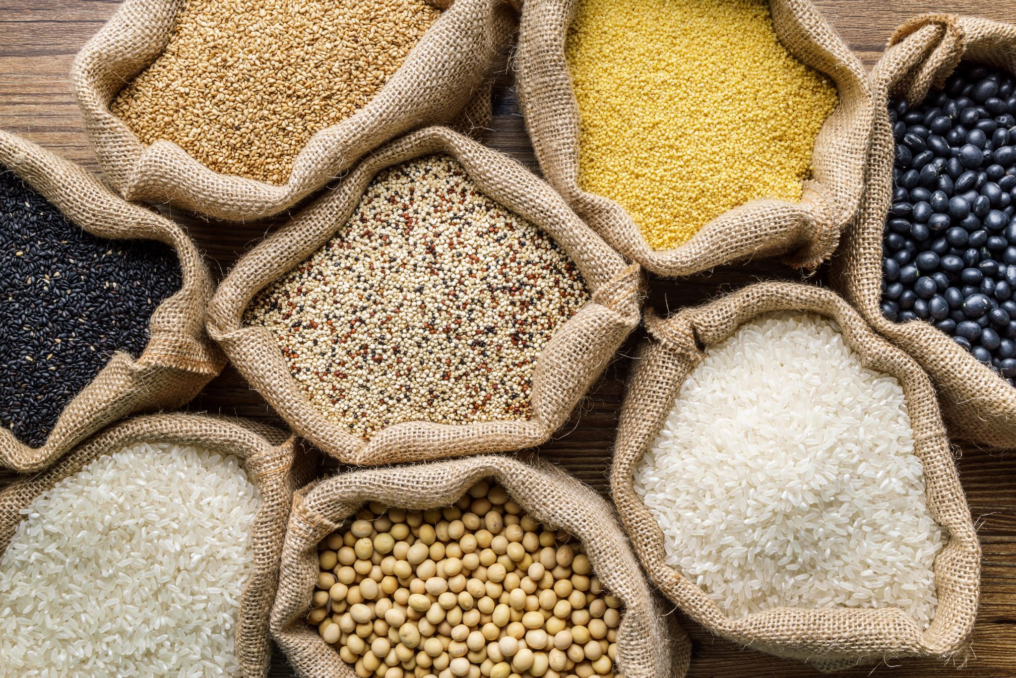
FOOD SECURITY
EMAIL ID: vyassidhi9@gmail.com
TEAM NAME: THE BEATLES
COLLEGE NAME: STANLEY COLLEGE OF ENGINEERING

Slide 2




TEAM MEMBERS
V.SIDHI
(TEAM LEADER) B.Akshay Kumar
T.Ananya Lasya G.Pranay Kumar
Bairi Nakshatra

Slide 3

Introduction
Overview of the Project
This project focuses on analyzing food waste data to enhance food security. Leveraging a dataset from Kaggle, the goal is to identify key patterns and insights that can aid in reducing food waste, thereby contributing to global food security. As a data analyst, my objective is to clean, preprocess, and analyze the dataset to derive actionable insights that can inform strategies for minimizing food waste.
Objective The primary objective is to analyze the food waste dataset to understand the underlying causes and patterns of food waste. The insights derived will be used to propose solutions that align with the United Nations' Sustainable Development Goals (SDGs), particularly those related to zero hunger (SDG 2) and responsible consumption and production (SDG 12).

Slide 4


Problem Identification Problem Statement Food waste is a significant issue affecting global food security. Despite sufficient food production, a large portion of food is wasted at various stages of the supply chain, leading to inefficiencies and contributing to hunger.
Significance of the Problem Addressing food waste is crucial for ensuring food security, reducing environmental impact, and promoting sustainable practices. By minimizing food waste, we can improve resource efficiency and ensure that more food reaches those in need.
Relevant SDGs SDG 2: Zero Hunger- Aiming to end hunger and ensure access to safe, nutritious, and sufficient food for all. SDG 12: Responsible Consumption and Production - Ensuring sustainable consumption and production patterns to reduce waste.

Slide 5


Data Collection Sources of Data The dataset used for this project was sourced from Kaggle, a platform known for its diverse and extensive collection of datasets. Data Description The dataset includes information on food waste at various stages of the supply chain, such as production, distribution, and consumption. It contains variables like food type, quantity wasted, reasons for waste, and geographical location. Data Cleaning Methods Removing Duplicates: Identifying and removing duplicate records to ensure data integrity. Standardizing Formats: Converting data into a consistent format (e.g., dates, measurement units). Handling Inconsistent Data: Correcting inconsistent entries to maintain uniformity.

Slide 6
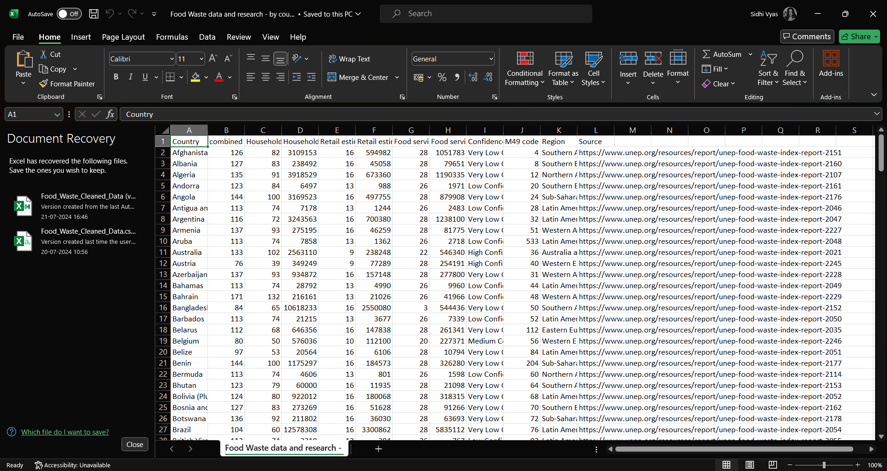
Dataset link: https://www.kaggle.com/datasets/joebeachcapital/food-waste/data

Slide 7
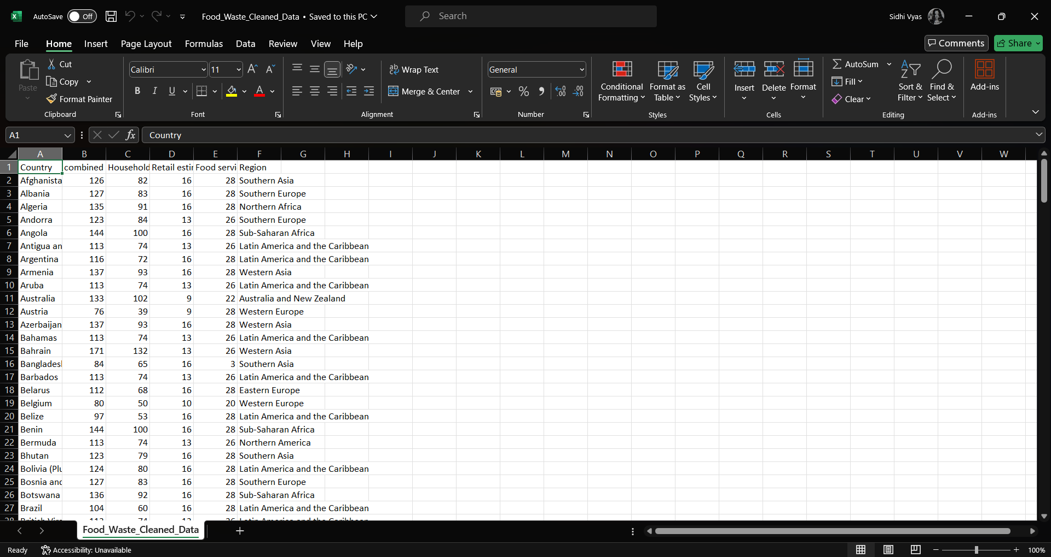
Cleaned Dataset

Slide 8

Data Preprocessing Data Cleaning Methods Handling Missing Values: Using techniques such as imputation or deletion to manage missing data. Outlier Detection: Identifying and addressing outliers that could skew the analysis. Normalization: Scaling numerical features to ensure they have a consistent range. Data Transformation Techniques Encoding Categorical Variables: Converting categorical data into numerical format using techniques like one-hot encoding. Feature Engineering: Creating new features based on existing data to enhance the analysis.

Slide 9




Data Analysis Analytical Tools and Methods Used Python Libraries: Pandas, NumPy, Matplotlib, Seaborn, and Scikit-learn for data manipulation, visualization, and analysis. Statistical Analysis: Descriptive statistics and inferential statistics to understand data distributions and relationships. Machine Learning Models: Regression analysis, clustering, and classification to identify patterns and predict outcomes. Key Findings Significant amount of food waste occurs at the consumption stage. Fruits and vegetables are the most wasted food types. Seasonal variations impact food waste levels. Insights Derived - Improving storage and transportation can reduce waste at the distribution stage. - Educating consumers on proper food storage and usage can minimize household waste.

Slide 10
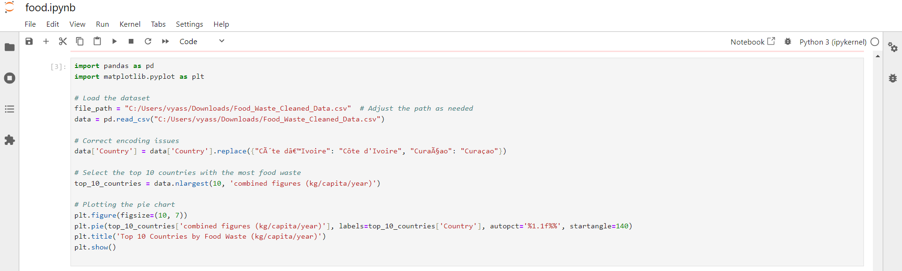
Snapshot of code in python

Slide 11
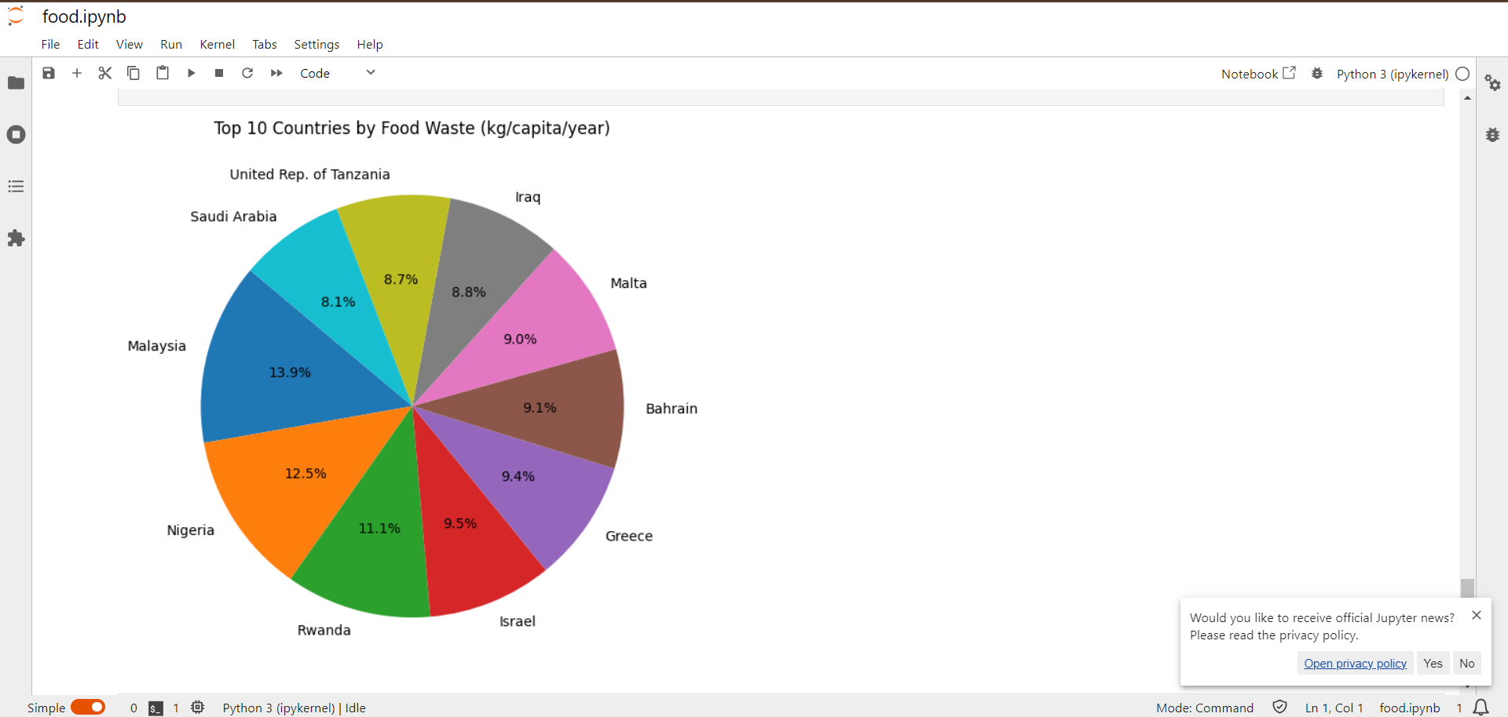
Snapshot of pie chart

Slide 12


Hypothesis Development Formulated Hypotheses - Hypothesis 1: Educating consumers on food storage techniques reduces household food waste. - Hypothesis 2: Improving supply chain logistics decreases waste during distribution. Rationale Behind the Hypotheses - Education and awareness can directly influence consumer behavior. - Efficient logistics can mitigate losses during transportation and storage. Method for Testing the Hypotheses - Experimental Design: Conducting controlled experiments and surveys to gather data on the impact of educational programs. - Data Analysis: Using statistical tests such as t-tests and ANOVA to evaluate the effectiveness of interventions.

Slide 13


Solution Design Proposed Solution Implement educational programs for consumers and optimize supply chain logistics to reduce food waste. Implementation Plan - Phase 1: Develop and distribute educational materials on food storage and usage. - Phase 2: Collaborate with logistics companies to enhance supply chain efficiency. - Phase 3: Monitor and evaluate the impact of interventions through regular assessments. Alignment with SDGs - SDG 2: Zero Hunger - Ensuring more food reaches those in need. - SDG 12: Responsible Consumption and Production - Promoting sustainable practices to reduce waste.

Slide 14


Visualization Data Visualization Techniques Used Charts and Graphs: Bar charts, line graphs, and pie charts to illustrate food waste trends and patterns. Maps: Geographical maps to display regional variations in food waste. Heatmaps: To show the intensity of waste across different food types and stages. Key Visual Insights Clear identification of high-waste regions and food types. Visualization of the impact of seasonal changes on food waste.

Slide 15


Conclusion Summary of Findings The analysis revealed critical stages and types of food that contribute most to waste. Educational programs and supply chain improvements are effective strategies to reduce waste. Impact of Proposed Solution Reduction in food waste leading to improved food security. Enhanced sustainability and resource efficiency. Future Work Expanding the analysis to include more datasets and variables. Long-term monitoring and evaluation of the implemented solutions.

Slide 16


References Data Sources Kaggle: Food Waste Dataset Tools and Software Used
Python (Pandas, NumPy, Matplotlib, Seaborn) Additional References United Nations Sustainable Development Goals (SDGs) documentation Relevant academic and industry publications on food waste and security

